Slide 1
CHRISTMAS TREE HILL
NEIGHBORHOOD RESPONSE GROUP
BLOCK CAPTAIN TRAINING

Slide 2
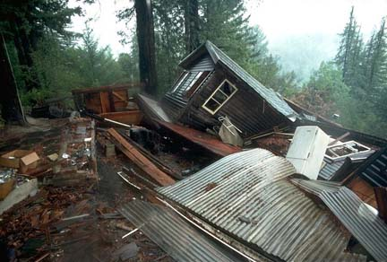
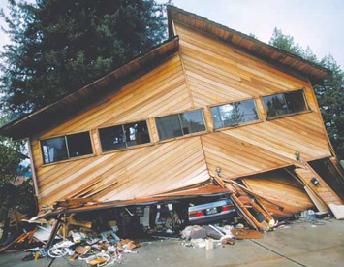
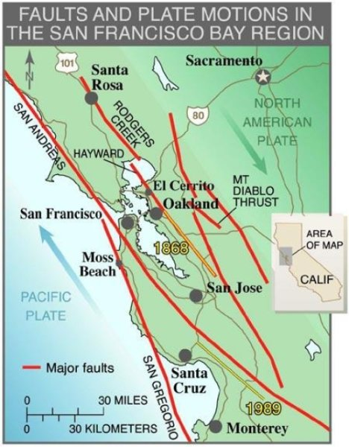
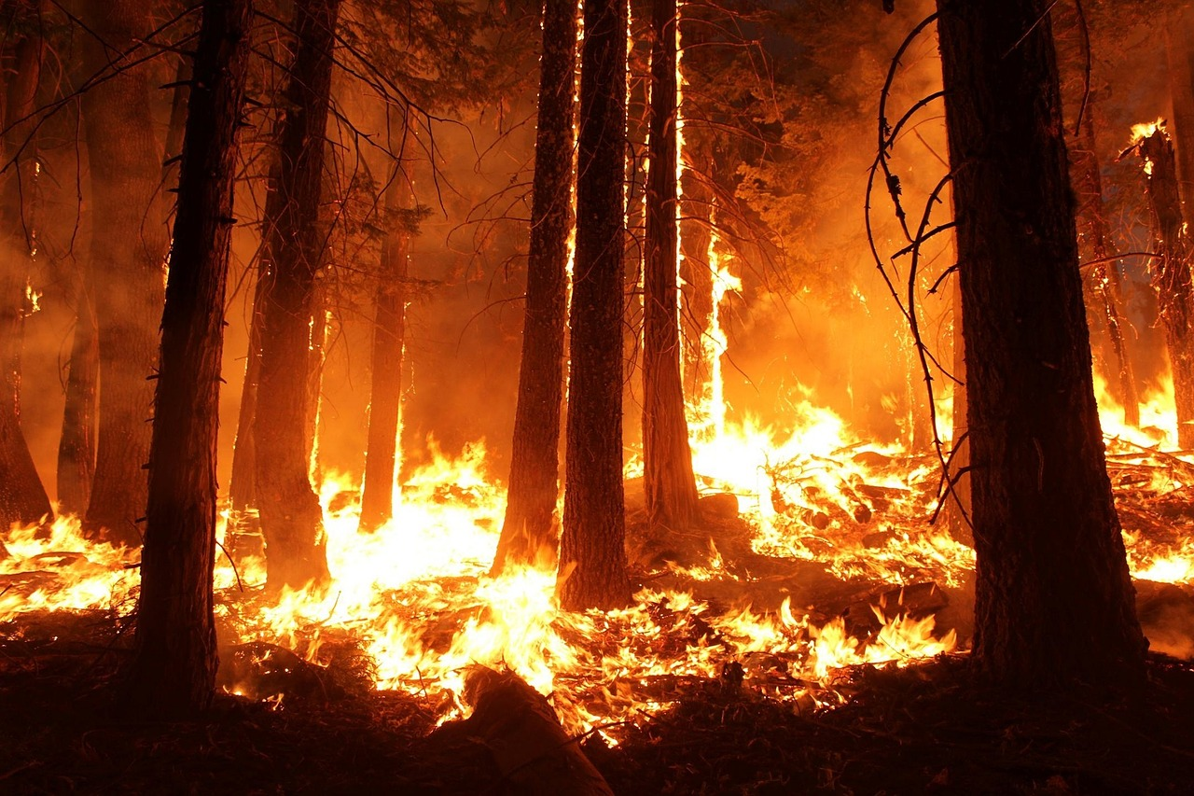
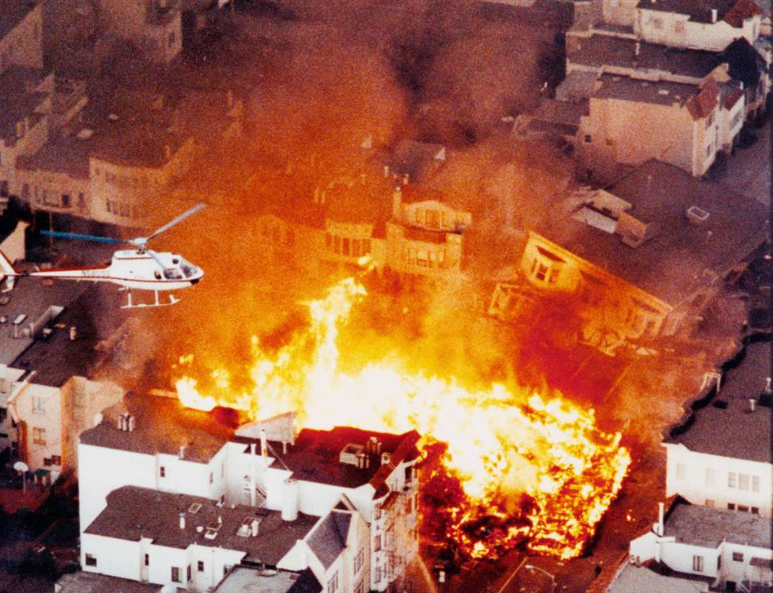

Slide 3
TRAINING OUTLINE & OBJECTIVES
By the end of the training you should ..
Understand the role & duties of a Block Captain before, during & after a disaster
Know how to prepare yourself to perform your duties
Know how to prepare the residents in your block
Know how to assess & report block/resident status
Know how to use your 2-way radio correctly
Understand the CTH NRG Communications System
Understand how Incident Command works
Have access to resources, equipment & supplies

Slide 4
OUR MISSION IS TO HELP THE RESIDENTS IN OUR BLOCK …
PREPARE FOR
RESPOND TO
RECOVER FROM
DISASTERS

Slide 5
By volunteering to be a Block Captain you have undertaken a serious responsibility & you have an ethical responsibility to the residents of your block & your NRG to fulfill your duties to the very best of your ability.

Slide 6
BLOCK CAPTAIN ROLE & RESPONSIBILITIES
Responsible for distributing & collecting information from the residents in your block;
Responsible for using a 2-way radio to communicate with Incident Command to report block status & in turn to sharing information with residents during and after an incident;
The emergency contact person for people in your block to notify about emergency response related activity, & for promptly notifying the NRG of any relevant information;
Required to participate in and help organize periodic (annual or biannual) emergency response drills.
As a BC you are:
Required to be prepared to carry out your duties
Responsible for the homes/residents assigned in your block;
Required to visit each resident/home in your block to meet neighbors to explain how the CTH NRG ER Team & Plan works;
Required to keep track of who is living in each home & to record names, telephone numbers, e-mail addresses, & other relevant information in the resident data base;

Slide 7
BEFORE AN EMERGENCY OR DISASTER

Slide 8
STEP 1: PREPARE YOUR OWN FAMILY ER PLAN
You will only be able to effectively fulfill your role as a BC if you and your family have an emergency response plan and if you have taken the necessary steps to be prepared for an emergency or disaster. The sites below (and many others) provide excellent emergency preparedness guidance, checklists, and supply kit content lists and purchase options.
https://www.ready.gov/wildfires
https://www.ready.gov/floods
https://www.ready.gov/earthquakes
https://www.ready.gov/animals
https://www.ready.gov/individuals-access-functional-needs
http://www.redcross.org/get-help/prepare-for-emergencies/be-red-cross-ready/get-a-kit
http://www.nsc.org/learn/safety-knowledge/Pages/safety-at-home-emergency-preparedness
https://www.fema.gov/pdf/areyouready/areyouready_full.pdf

Slide 9
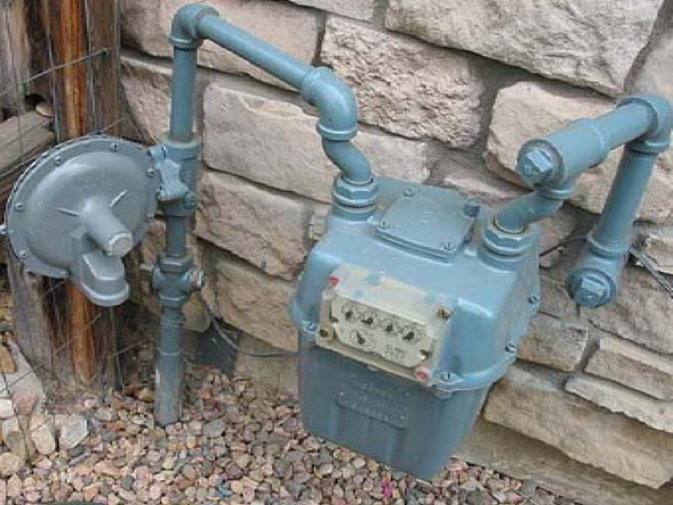
KNOW HOW TO SHUT OFF YOUR GAS!

Slide 10
STEP 2: PACK A BC BACKPACK
Flashlight / headlamp
2-way radio & instructions
Batteries
Water & energy bar
Pen, marker & notepad
Gloves (latex & heavy)
Small first aid kit
BC resident information print-out
Emergency contact numbers
Map of the block & the hill showing evacuation routes
Assessment forms
BC Vest & helmet
Duct tape

Slide 11
STEP 3: PREPARE & GET EDUCATED
Sign up for Marin.org alerts:
https://www.marinsheriff.org/services/emergency-services/alert-marin
Sign up for Nixle alerts:
https://local.nixle.com/city/ca/
Walk your block, know the entrance and exist points of the homes in your block
Find and become familiar with the evacuation routes nearest to your block and take note of any unusual barriers or obstacles to evacuation
Study a map of the hill and of your block and review your designated area carefully:
https://www.google.com/maps
https://nextdoor.com/neighborhood/christmastreehill--corte-madera--ca/
Try your best to attend CERT or other emergency preparedness and response training:
https://readymarin.org/calendar/
https://training.fema.gov

Slide 12
STEP 4: PREPARE FOR YOUR MEET & GREET SESSIONS WITH THE RESIDENTS IN YOUR BLOCK
Using a method that best suits you:
Make arrangements to visit each home in your block at a designated time.
Prepare a package for each resident (Get Ready checklist, blood stop kit, resource guide, map of the hill with evacuation routes, etc.).
Practice your presentation before your first meeting.
Prepare a clip board with the necessary forms.
Have a photo ID with you.
Take your back pack and vest with you so that residents can see what tools you will use and how they can identify you.

Slide 13
STEP 5: CONDUCT YOUR MEET & GREET SESSIONS
Arrive on time if pre-arranged
Introduce yourself and the CTH NRG, and give a brief overview of the NRG’s mission and purpose
Make your presentation
Tell the resident about the annual/bi-annual drills and explain the procedure of posting a status sign on the house after an incident
Complete the resident/household information form with the resident(s)
Invite the resident(s) to volunteer as a BC, ZC, Medical Team member, or by providing other needed assistance (like website design)
Encourage the resident(s) to prepare adequately by viewing the referenced resources
Encourage the resident(s) to sign up immediately for Alert Marin and Nixle
Make sure the resident(s) know where their evacuation routes are and what the block boundaries are

Slide 14
IF YOU CANNOT MEET PERSONALLY WITH RESIDENTS ….
Obtain resident outreach letters from Soren Jensen (also available on the website for downloading) for mailbox distribution, along with:
OK/HELP sign
Stop bleeding kit
A volunteer application form and Resident Information form is attached to the letter
Deliver the letters and other items to the residents in your block. If after 2 weeks you have had no response from one or more residents, send them a reminder letter (these can also be obtained from Soren, or downloaded from the website).

Slide 15
STEP 6: UPDATE THE BLOCK DATA BASE
After each resident meet and greet session or upon receipt of resident information forms, update the block resident data base & forward a copy of the resident/household information sheet to Cinda van Lierop at CTHNRG@gmail.com so that the central data base can be updated. The data base must also be updated whenever a new resident moves in to the block, moves/ leaves the block, or whenever any residents important household information changes.
The resident data base spreadsheet can be found on the website

Slide 16
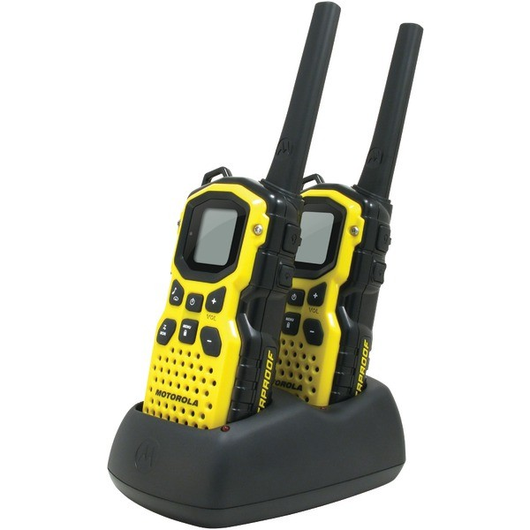
STEP 7: LEARN HOW TO USE YOUR
2-WAY RADIO CORRECTLY
There is a monthly radio test for all BCs. Learning the basic operating guidelines for the use of two way radios is something which is extremely important prior to use.
You do not need to be polite, only succinct. The communication and getting your point across is the key to success. Less communication is the best way to talk over two way radios. Keep your message short and efficient.
You should already know what you plan to communicate over the radio before you start talking into it.
There is no privacy when transmitting on open channels. Anything that you say over these channels can be picked up by anyone else who is listening to the same frequency.
Repeat information given to you back to the person who provided it. This will ensure proper communication between parties.
https://quality2wayradios.com/store/two-way-radio-etiquette

Slide 17
STEP 8: PARTICIPATE IN DRILLS
Two Drills will take place each year on daylight savings dates
The primary purpose of the drills is to:
Test and practice 2-way radio use and protocols
Give block captains and zone coordinators an opportunity to practice their roles
Foster teamwork
Practice evacuations
Interact with residents & promote disaster preparedness
Block captain responsibilities include assisting with the organization and successful execution of bi-annual drills.

Slide 18
STEP 9: RECRUIT VOLUNTEERS
One of your very important responsibilities as Block Captains, Zone Coordinators, and Steering Committee Members is to recruit volunteers for the following key positions:
Block Captains
Zone Coordinators
Medical Team members
Organization support volunteers (data base development, website development, graphics, various administrative tasks, etc.)
Meet and greet sessions with residents provide an excellent opportunity to encourage residents to become NRG volunteers.

Slide 19
DURING AN EMERGENCY OR DISASTER
(hazard conditions permitting)

Slide 20
FIRST: Attend to your own family and house and implement your own personal family response plan.
Time permitting, remember to:
Check for gas leaks, & shut off the gas meter if you smell gas
Turn off the water intake from the street to keep out pollutants
Turn off the hot water heater to preserve clean drinking water.
(See lessons learned from Sonoma/Napa fires)

Slide 21
CTH NRG ER TEAM MOBILIZATION
THE CTH NRG ER TEAM will mobilize in response to an earthquake or fire, or any other other declared major disaster. To determine whether to mobilize, turn on your two-way radio and listen for Incident Command to activate the radio network. Alternatively respond to a mobilization call or text.
When your family/house is safe, turn your attention to the block.
Put on your BC backpack
Turn on your 2-way radio
Put on your NRG vest and helmet

Slide 22
INCIDENT COMMAND SYSTEM
An Incident Command System (ICS) is the standardized method of managing emergency response. It is what emergency first responders—fire, police, County Sheriff, etc.—would expect to see should they have to interface with CTH NRG. If a major emergency or disaster is declared, the County’s Emergency Operations Center (EOC) will activate.
The CTH NRG Incident Command Center may be located at Menke Park, or in an alternate location to be announced.
The ICS is flexible and may be virtual (i.e., via 2-way radio only). The system will expand and contract according to the type of incident and staffing levels.

Slide 23
IC TEAM RESPONSIBILITIES
MISSION: Manage & Coordinate the CTH NRG Disaster Team response
PRIMARY RESPONSIBILITIES:
1. Report to Incident Command Center in response to mobilization message or in recognition of a major earthquake, wildfire or other declared disaster/emergency.
2. Receive, record & respond to incident reports from Block Captains
3. Ensure all blocks are covered
4. Dispatch assistance from Medical Team or other available resources
5. Liaise with first responders & authorities for assistance
6. Gather & share information

Slide 24
INCIDENT COMMAND TEAM ROLES
Staffing permitting, the CTH NRG IC Team is expected to have:
An Incident Commander (IC): The person providing overall coordination of all activities & making key response decisions.
An Operations Officer: The person responsible for overall set-up, coordination, resources, logistical support & IC operations.
A Communications & Liaison Officer: The person serving as liaison between the Incident Commander, first responders, CERT, government agencies, other NRG’s & the ER Team
A Zone Coordinator/Block Captain Leader a/k/a Situation Unit Leader: The person receiving information from the ZCs, BCs and others, who provides direction & guidance, & who organizes and records the information and passes it on to appropriate responders
A Medical Team Leader: The person in charge of the neighborhood medical team.
A Search and Rescue Team Leader: A CERT trained person in charge of the neighborhood CERT team.

Slide 25
The CTH NRG Incident Command Structure
INCIDENT COMMANDER
COMMUNICATIONS OFFICER
OPERATIONS/ LOGISTICS OFFICER
MEDICAL TEAM LEADER
SITUATION RESPONSE LEADER
Lead Zone Coordinator
CERT SEARCH & RESCUE LEADER
BLOCK CAPTAINS

Slide 26
INCIDENT COMMAND continued
The listed job titles are specific to the roles, and should be used in all communications, as they will be understood by any professional emergency responder. To be even marginally effective, the Incident Commander, Communications Liaison, & Situation Response Unit Leader positions should be filled.
The Steering Committee will pre-assign volunteers to these roles, with some redundancy to help account for absences. As soon as the assignments are made block captains will be notified.

Slide 27
IMPACT ASSESSMENTS
INJURIES: BC’s are expected only to assess injuries & report them. If you have first aid training or you are a CERT trained, you will be better able to assess the degree of injury. If untrained, do your best and seek prompt help from the Medical Team via your 2-way radio. In life and death situations you may take whatever action you deem appropriate to the circumstances.
HAZARDS: BC’s are expected to assess hazards and report them.
Utility wires down - ASSUME ALL DOWNED WIRES ARE HOT
Gas leaks
Building/infrastructure damage – look for obvious signs of damage. Do not express opinions about habitability.

Slide 28
ASSESSMENT REPORTING
When describing assessments use these terms:
No impact
Light Impact: For example - Occasional cracks in walls. Trees down but no visible structural damage. No structures at obvious risk. No serious personal injuries. No structures burnt. Minor vegetation burn but no uncontained wildfire in block area.
Moderate Impact: For example - Power line(s) down. Some personal injuries, but not life-threatening. Some fire damage to houses but none appear to be structurally failing or completely destroyed. Contained wildfire in area(s) within block.
Heavy Impact: For example - Moderate plus one or more houses tilted, off foundations or destroyed. Life-threatening injuries to one or more persons. Uncontained wildfire in progress in or near home/block.

Slide 29
ASSESSMENT PROCESS
SERIOUS INJURY OR HAZARD: Radio in immediately. For all other information, make one combined report when block is complete.
Conduct door-to-door surveys of assigned homes. Look for OK and HELP signs; prioritize HELP and NO SIGN homes.
Using the form provided assess injuries and damage and report conditions promptly to IC. If you have CERT or First Aid training, provide hands-on first aid assistance.
NO SIGN: knock loudly, repeatedly. Identify yourself. Do not enter unless you see or hear someone needing help. (Discuss action)
HELP SIGN: Knock and call; if no response, immediately report location to IC.
UNINHABITABLE HOME (as determined by homeowner): Recommend occupants shelter with a neighbor, or use camping equipment (if any) and remain on own property, if safe to do so.
HABITABLE HOMES (as determined by homeowner): Recommend residents remain if no ongoing threat.
Record all inspected households on clipboard form.
Remain in neighborhood; monitor block until IC or the authorities declare the emergency is over.

Slide 30
AFTER AN EMERGENCY OR DISASTER
(hazard conditions permitting)

Slide 31
CONTINUE OR COMMENCE POST-INCIDENT ASSESSMENTS
(see prior section)

Slide 32
POST-INCIDENT DEBRIEFING
Once the ALL CLEAR is given, and if your home/family is safe, proceed to the Incident Command Center for a debriefing. Take with you all incident notes, assessments, surveys and prepare to provide feedback on what worked, what did not, and what additional recovery assistance and activities are needed in your block.

Slide 33
RESOURCES
www.ReadyMarin.org Www.NRGMarin.org
https://local.nixle.com/city/ca/
https://www.marinsheriff.org/services/emergency-services/alert-marin
https://www.ready.gov/wildfires
https://www.ready.gov/floods
https://www.ready.gov/earthquakes
https://www.ready.gov/animals
https://www.ready.gov/individuals-access-functional-needs
http://www.redcross.org/get-help/prepare-for-emergencies/be-red-cross-ready/get-a-kit
http://www.nsc.org/learn/safety-knowledge/Pages/safety-at-home-emergency-preparedness
https://www.fema.gov/pdf/areyouready/areyouready_full.pdf

Slide 34
Thank you for volunteering!
Q & A

